Slide 1


DeepFake Detection in Digital Forensics Using Advanced Machine Learning Techniques
Presented By: ANJALI SINGH
RASHMI KADU ROHINI BHARNE
Supervised By:
Dr. Priya Dasarwar
Symbiosis Institute of Technology, Nagpur Campus (SIT-N)

Slide 2

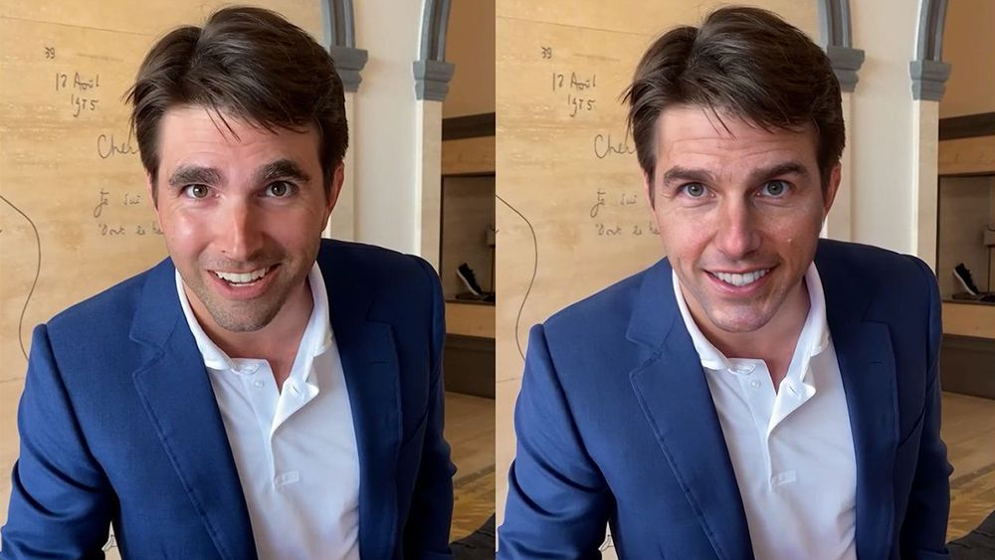
Introduction
Rapid AI advancements have led to the rise of DeepFakes-realistic digital alterations that distort audio and video.
These DeepFakes can create misleading representations, posing a serious challenge in the digital age.
The project's goal is to detect and prevent the spread of manipulated media effectively.

Slide 3
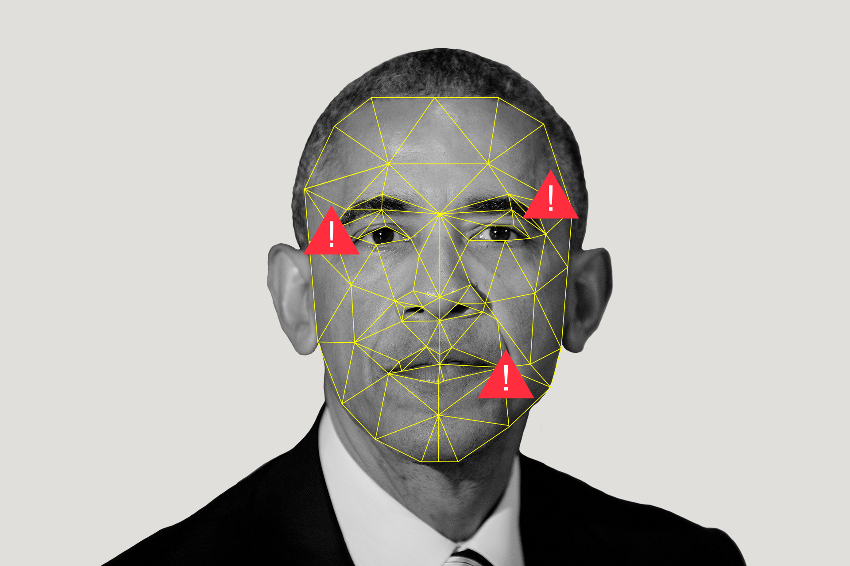
Background
DeepFakes have become a critical issue in the digital world due to their increasing realism. The difficulty in distinguishing between genuine and manipulated content is a growing concern.
The rise of DeepFakes is driven by sophisticated AI techniques, especially in machine learning. These techniques enable seamless alterations in audio and video files.
This project aims to build on existing research and methodologies to address this issue.
It will utilize Recurrent Neural Networks (RNNs) and Convolutional Neural Networks (CNNs) to analyze media for signs of tampering. The project contributes to the broader effort to combat misinformation.

Slide 4

Problem Statement
As DeepFakes become more sophisticated and harder to detect, there is an urgent need for a reliable detection system that can identify these manipulations accurately and efficiently. The main challenge lies in developing an algorithm that can detect subtle discrepancies in media files and prevent the spread of false information. Additionally, the system must be user-friendly to ensure accessibility for non-experts.

Slide 5
Objective
Utilizing Comprehensive Datasets: Training the detection algorithm on a vast dataset of authentic and manipulated media to improve accuracy.
Developing a Detection System: Implementing machine learning models (RNNs and CNNs) to identify anomalies in audio and video content.
Contributing to Misinformation Mitigation: Supporting efforts to combat digital misinformation by providing a tool that can identify DeepFakes.
Creating a User-Friendly Interface: Designing an interface that allows easy verification of media authenticity, even for non-technical users.

Slide 6
Objective
Utilizing Comprehensive Datasets: Training the detection algorithm on a vast dataset of authentic and manipulated media to improve accuracy.
Developing a Detection System: Implementing machine learning models (RNNs and CNNs) to identify anomalies in audio and video content.
Contributing to Misinformation Mitigation: Supporting efforts to combat digital misinformation by providing a tool that can identify DeepFakes.
Creating a User-Friendly Interface: Designing an interface that allows easy verification of media authenticity, even for non-technical users.

Slide 7
Timeline
JULY
Research and Literature Review
AUG
Model Development & Training
SEPT
Testing and Validation
AUG
Data Collection and Preprocessing
SEPT
Model Evaluation, Refinement & Full Integration
NOV
Final Report and Presentation

